Slide 1

Using Wait Stats to Determine Why My Server is Slow
Dustin Dorsey

Slide 2

Who am I?
Director of Data Management for Lifepoint Health
Email - Dorsey.Dustin@att.net
LinkedIn – linkedin.com/in/dustindorsey
Twitter - @sql_dd
Blog - https://dustindorsey.com/
Github - https://github.com/dustin-dorsey
I have been working with SQL Server for over a decade in development and administration
Active speaker and blogger

Slide 3
Things you will learn
What wait statistics are, how you read them and some common misconceptions about them
What role server resources play in the big picture of query processing
How waits occur within query processing
About common waits that may be slowing down your servers and how to fix them

Slide 4


Slide 5

No, its your bad code that is slow!
Your server is slow!
Dev Team
DBA
Notes:
Who is to Blame? The answer is it could be either, but knowing how\where to check is what is important

Slide 6
What is a Wait Statistic?
They are numbers that are collected that provides visibility into areas where SQL Server spends time waiting to do the work.
Aggregated wait statistics are captured in sys.dm_os_wait_stats and waits stats for executing requests are stored in sys.dm_os_waiting_tasks
Notes:
SQL Server can wait for:
Resources – CPU, memory, Disk, network, locks, etc.
Things outside of SQL – OLEDB, CLR
System Tasks – Trace, full text search
SQL Server does a really good job providing you information on what you are waiting on

Slide 7

Waits describe symptoms… not root cause
Notes:
Wait stats are a symptom of an issue…. not a definitive determination of the issue
* If you go to the doctor with a sickness such as a stomach ache (wait stat), the doctor does not diagnose you with a stomach ache instead they would look for the root cause – Kevin Kline\ Paul Randall
Waits also are a good way to look at overall server performance, not necessarily individual query performance

Slide 8

Waits are normal!
Notes:
Waits are normal and how SQL Server works. You will always have a top wait
If you want to get proactive, you need to use baselines

Slide 9
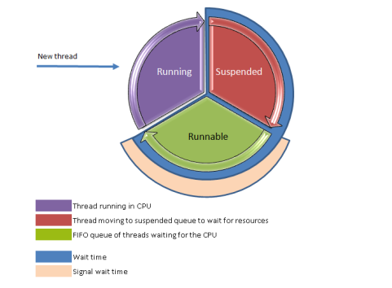
SQL Server Scheduling
Image from https://krishnakumarsql.wordpress.com/2014/08/01/sql-server-thread-cycle/
Notes:
New thread comes in as Running
When the thread needs to wait on something, it moves to Suspended
When the resource it needs become available, it moves to a Runnable state
First in, first out
From Runnable, the query will move into a Running State when the CPU is ready to process
The cycle repeats until the query completes.
Waits are normal and is the way that SQL works
There are 2 types of waits:
Signal waits
Resource Waits
The DMV captures the Total Wait, the part you want to look at is the Total Wait minus the Signal wait. This is time spent waiting on a resource to become available.

Slide 10
Let’s take a look

Slide 11

High level query processing
SQL Server
Memory
CPU
Storage
Network
End User

Slide 12
Life of a SELECT
SQL Server
Memory
User sends in Query
CPU
Storage
Network
End User

Slide 13
Life of a SELECT
SQL Server
Memory
CPU looks for the data in cache
CPU
Storage
Network
End User

Slide 14
Life of a SELECT
SQL Server
Memory
If data is not available in memory, it reads it from disk into memory
CPU
Storage
Network
End User

Slide 15
Life of a SELECT
SQL Server
Memory
Filter through the data, request locks, and
may do some TempDB
operations
CPU
Storage
Network
End User

Slide 16
Life of a SELECT
SQL Server
Memory
Each of these arrows
represent a place a
wait can occur
CPU
Storage
Network
End User
Results get sent back to the user

Slide 17
Life of a DELETE, UPDATE, INSERT
SQL Server
Memory
User sends in Query
CPU
Storage
Network
End User

Slide 18
Life of a DELETE, UPDATE, INSERT
SQL Server
Memory
CPU looks for the data in cache
CPU
Storage
Network
End User

Slide 19
Life of a DELETE, UPDATE, INSERT
SQL Server
Memory
CPU
Storage
Network
End User
If not found in cache, then gets it from Disk

Slide 20
Life of a DELETE, UPDATE, INSERT
SQL Server
Memory
Locks are taken on the data (slice
and dice of data)
CPU
Storage
Network
End User

Slide 21
Life of a DELETE, UPDATE, INSERT
SQL Server
Memory
Data is updated in memory
CPU
Storage
Network
End User

Slide 22
Life of a DELETE, UPDATE, INSERT
SQL Server
Memory
CPU
Storage
Network
End User
Data is written to the log file synchronously
Notes:
Synchronous (Before commit)

Slide 23
Life of a DELETE, UPDATE, INSERT
SQL Server
Memory
CPU
Storage
Network
End User
Data file changes happen asynchronously
Notes:
Asynchronous (After commit)

Slide 24
Life of a DELETE, UPDATE, INSERT
SQL Server
Memory
Each of these arrows
represent a place a
wait can occur
CPU
Storage
Network
End User
Results are sent back to the user

Slide 25
Network Waits
Network
SQL Server
End User
ASYNC_NETWORK_IO
Other things to check:
Network utilization
Code that is executing
Notes:
ASYNC_NETWORK_IO – This wait indicates that either the session is waiting for the client application to process the result set and send a signal back to SQL Server that it is ready to process more data (Waiting for Ack). The second is that there may be a network performance issue.
* RBAR

Slide 26
Disk Waits
CPU
Storage
Other things to check:
System utilization
Code that is executing
Disk Latency
Historical trends (baselines)
PAGEIOLATCH_XX
WRITELOG
ASYNC_IO_COMPLETION
Notes:
PAGEIOLATCH – Reads
WRITELOG, ASYNC_IO_COMPLETION – Writes
PAGEIOLATCH_XX - waiting for a data file page to be brought from disk into the buffer pool so its contents can be read
Possible issues: more memory pressure, workload has increased, problems at the IO\subsystem layer, Network latency, separate workload creating contention, IO replication/mirroring
(DT- Destroy, EX – Exclusive, KP- Keep, NL- NULL, SH- Shared, UP - Update
WRITELOG – waiting to write the contents of the log cache to disk where the transaction log is stored
IO_COMPLETION – Tasks waiting on I/O to complete, typically non-data pages – Typically seen along with one of these other waits
ASYNC_IO_COMPLETION – Occurs while wait for non-data-file disk I/O (Backups\Restores)

Slide 27
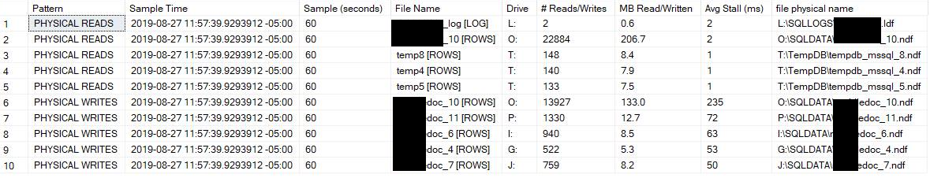
Sp_CheckIO
Stored procedure that uses sys.dm_io_virtual_file_stats to track disk latency over a specified length of time
(modified version of the code found in sp_blitzfirst)

Slide 28
Memory Waits
Memory
RESOURCE_SEMAPHORE
LCK_M_XX
* Disk Waits
Some other things to check:
Memory utilization
System utilization
Head blockers
Code that is executing
Historical trends (baselines)
CPU
Notes:
Disk waits can also factor into this
Lock wait also occur in memory, but not tied to memory – locking, blocking, long running transactions. Tied to the query
RESOURCE_SEMAPHORE – Whenever a SQL query runs, memory has to be granted to it. If there is not enough memory available, it will result to this wait. The Resource Semaphore is what grants the memory

Slide 29
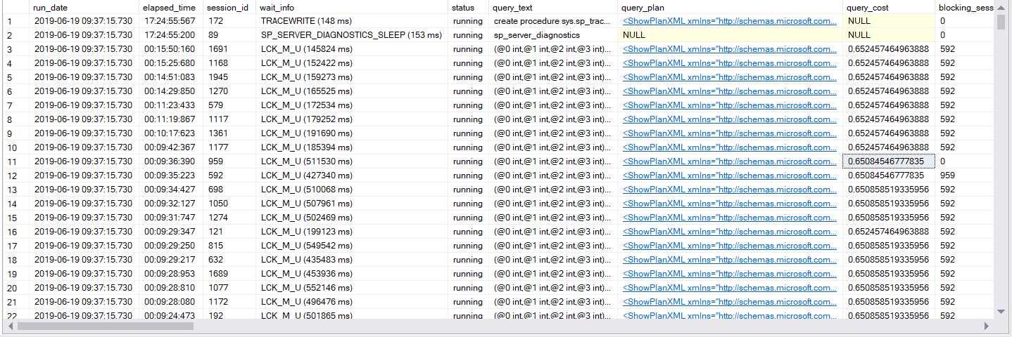

Memory Waits

Slide 30
CPU Waits
CPU
Some other things to check:
CPU utilization
System utilization
Code that is executing
Historical trends (baselines)
SOS_SCHEDULER_YIELD
CXPACKET
*Signal waits
Notes:
SOS_SCHEDULER_YIELD – means that the SQLOS is waiting for the CPU scheduler to yield more time. See Example.
* Do not incorrectly assume that changing MAXDOP or more CPU power is the answer. Could be queries (scan, sorts, etc.)
CXPACKET\CXCONSUMER – This oftentimes is not an issue and just indicates that Parallelism is taking place.
* Good – Parallelism is occurring
* Bad wait – You have threads waiting for other to complete
* In new release, the good wait has been made into its own wait type – CXCONSUMER (2016 SP3 CU3, SQL 2017 CU3, Azure SQL DB
* You can ignore this one and if you are still seeing high CXPACKET waits it could be a bad plan\statistic issue
High Signal waits can indicate CPU issues

Slide 31
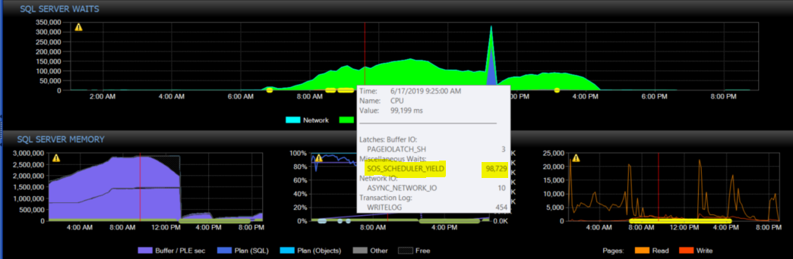
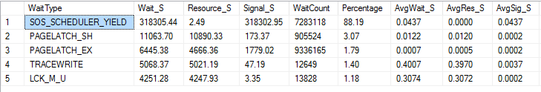
CPU Waits

Slide 32
Let’s take another look
Notes:
New thread comes in as Running
When the thread needs to wait on something, it moves to Suspended
When the resource it needs become available, it moves to a Runnable state
First in, first out
From Runnable, the query will move into a Running State when the CPU is ready to process
The cycle repeats until the query completes.
Waits are normal and is the way that SQL works
There are 2 types of waits:
Signal waits
Resource Waits
The DMV captures the Total Wait, the part you want to look at is the Total Wait minus the Signal wait. This is time spent waiting on a resource to become available.

Slide 33
Troubleshooting using Waits
Check active queries running and see if there are waits associated with them
Establish baselines so you can tell what changed when a problem occurs
Use other performance monitoring methods in conjunction – monitoring tools, perfmon, etc.
Remember that waits are a symptom of a problem and do not diagnose the problem. It could be the server or it could be the code.

Slide 34
Links
https://www.sqlskills.com/blogs/paul/wait-statistics-or-please-tell-me-where-it-hurts/
http://www.sqlskills.com/wp-content/uploads/2014/04/sql-server-performance-tuning-using-wait-statistics-whitepaper.pdf
https://www.sqlskills.com/help/waits/
https://app.spotlightcloud.io/public/waitopedia
https://sqlperformance.com/2015/03/io-subsystem/monitoring-read-write-latency

